Slide 1
Sport News Application
Team members:
Mohsen Amirian
Marziye Sarvarizade
Ognjen Ostojic

Slide 2
Motivation
The primary goal of the Sport News app is to create an all-in-one platform where sports fans can easily access comprehensive and real-time updates on their favorite sports. By integrating various features like live scores, detailed articles, user comments, and exclusive content, the app aims to enhance the user's engagement and make staying informed both convenient and enjoyable.

Slide 3
Product Statement
The Sport News app is designed to provide users with up-to-date sports information, live scores, detailed articles, and exclusive sports analysis. It helps sports enthusiasts who want to stay informed about various sports such as football, basketball, and more, with easy navigation and an engaging user experience.

Slide 4
Limitations
01
No Live Streaming
Initial version lacks live video streaming.
02
Limited Sports
Limits
Focuses on mainstream sports only, such as football, basketball and volleyball.
03
Regional Gaps
Limited coverage of nice competitions.
04
Basic User Interaction
Limited to commenting and reading; no advanced social features.

Slide 5
Business Requirements
Functional Requirements:
Home page displaying live scores and major highlights.
A slider for important matches and ongoing events.
Categories for easy navigation: Latest News, Most Read, Transfers, and Match Highlights.
Article detail pages with multimedia elements (e.g., photos, comments, and related articles).
Subscription page with different user benefits (e.g., exclusive content, live updates).
Search functionality for articles and content.
User comments section on article pages.
Non-functional Requirements:
Must load pages within 5 seconds.
24/7 uptime with a 99.5% availability guarantee.
Data encryption for user information.
Responsive design for mobile and desktop platforms.

Slide 6
Personas
Person A
Name: Jake Thompson
Age – 28
Gender – Male
Hobbies – Playing soccer, watching live sports, streaming podcasts, hiking
Typical day – Jake wakes up early to go for a morning run. He then heads to his job as a marketing manager at a sportswear company. During lunch, he reads sports articles and checks live scores. In the evening, he meets friends for a pickup soccer game or watches sports highlights at home.
Short history – Jake has been a lifelong sports enthusiast, playing soccer since he was a child. He studied Sports Management at university and worked his way up in the marketing world. He loves sharing sports stats and stories with friends and stays updated on sports news across various leagues.it frustrating when a website is cluttered or slow to load.

Slide 7
Personas
Person B
Name: Lisa Martinez
Age – 32
Gender – Female
Hobbies – Writing blogs, photography, reading match analyses, attending live games
Typical day – Lisa begins her day by reviewing the latest sports headlines for her blog. She works as a freelance sports writer and spends afternoons attending press events or games to take photos and collect insights. In the evenings, she updates her blog with match recaps and connects with her online followers.
Short history – Lisa developed a passion for sports reporting during her college years, where she studied Journalism. Over time, she built a dedicated following for her detailed match analyses and game-day photos. She enjoys blending her love of writing with real-time sports coverage and aims to inspire fans through her work.

Slide 8
Personas
Person C
Name: Ethan Kim
Age – 22
Gender – Male
Hobbies – Basketball, gaming, social media, watching highlights
Typical day – Ethan, a university student majoring in Sports Science, wakes up late and attends lectures. Between classes, he checks social media for game highlights and sports memes. In the afternoon, he plays basketball with friends and streams gaming content at night while keeping an eye on live scores.
Short history – Ethan grew up playing basketball and aspired to become a sports coach. Although he shifted his focus to studying sports science, he remains an avid fan, often sharing sports content online. He enjoys interacting with other fans on social media and dreams of working for a major sports network.

Slide 9
Credentials for Testing
Jake Thompson
Email: jake.thompson@example.com
Password: soccer123
Lisa Martine
Email: lisa.martinez@example.com
Password: sportsblog321
Ethan Kim
Email: ethan.kim@example.com
Password: basketball456

Slide 10
Users' Goals Definition for Sport News App
Seamless Navigation: Navigate easily through the app with intuitive UI elements for fast access to live scores and articles.
Enhanced Reading Experience: Enjoy well-structured articles with embedded multimedia content, such as photos and video snippets, that enrich the reading experience.
Optimized Search Functionality: Quickly find specific articles or game stats using an efficient search bar with auto-suggestions and filters.
Personalized Content Feed: View a customized feed based on selected sports and preferences.
Quick Access Menu: Use a collapsible side menu for direct access to popular sections like "Live Scores" and "Top Stories."
User Login/Registration: User login feature along with registering option.
View Latest News and Collections: Access a quick list of the latest articles and highlights.

Slide 11
Users' Goals Definition for Sport News App
Category Browsing: Browse articles and content by specific sports or categories.
Content Filters: Filter articles by category, date, or type to find relevant information quickly.
User Account Management: Manage profile details and app settings with ease.
About the App: View information about the app and its purpose.
Subscription and Payment: Manage subscription options and payment preferences for exclusive content access.

Slide 12
Sports News Application User Goals
View the latest sports news
Explore different sports categories (e.g., football, basketball, tennis)
Read full articles in detail
Search articles by keywords or topics
Filter articles by category, date, and popularity
Register and login for personalized content
Subscribe to newsletters or notifications
Manage user profile (e.g., personal information, preferences)
Contact us for inquiries
Learn more about the app (about us)
View terms and conditions

Slide 13
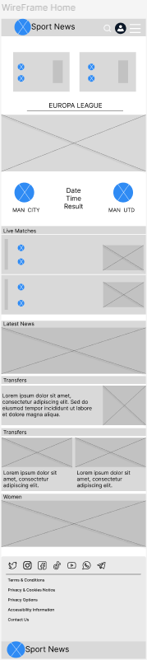
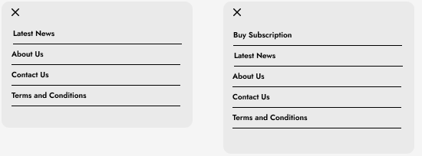
Wireframes
Home Page Menu without login Menu with login

Slide 14
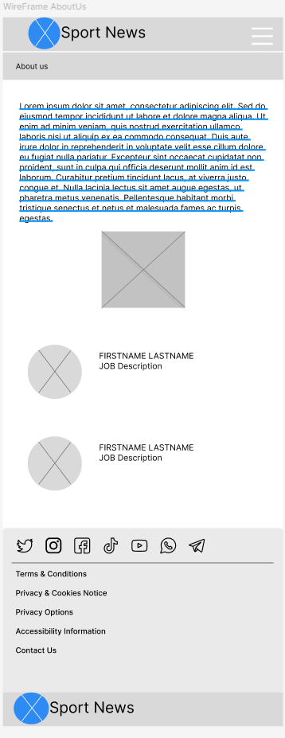
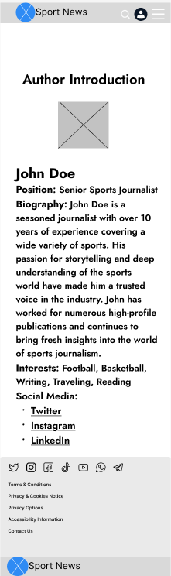
Wireframes
About us Author

Slide 15
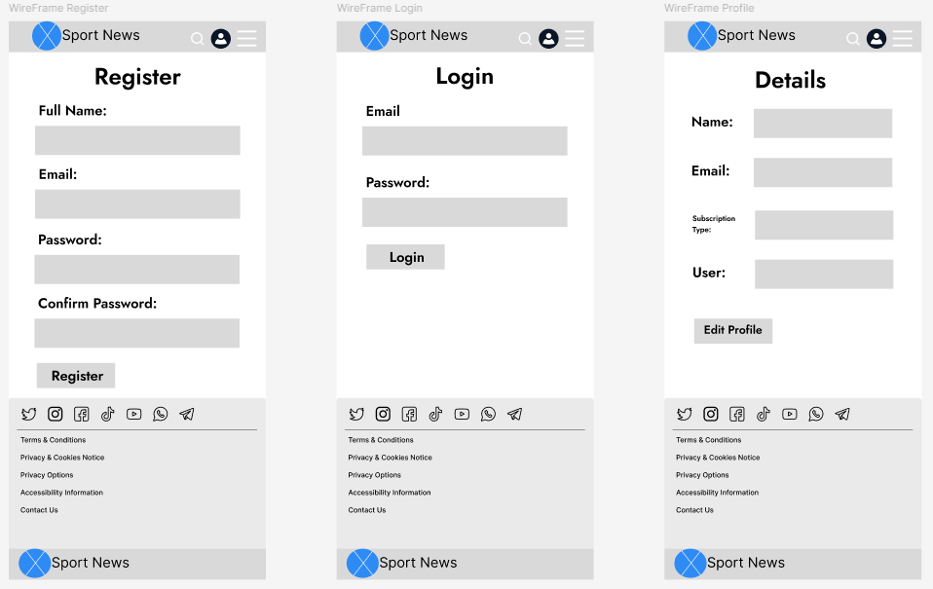
Wireframes
Register Login Profile

Slide 16
THANK YOU

